Slide 1
Working with Docker Containers in Windows 10
Presenter: Maximo Trinidad
Technology Evangelist
SAPIEN Technologies, Inc.

Slide 2
NYC PowerShell User Group Thank You for having me!

Slide 3


Agenda
About Me
SAPIEN Technologies Products
About Windows Subsystem for Linux
Windows SL Demo
About Docker Containers
Docker Demo
Technologies At Play
Windows Terminal
.NET Interactive / Jupiter Notebook
Custom Windows Application
Demo

Slide 4


About Me
Florida IT Community Speaker since 2006 attending:
.NET Code Camps
SQLSaturday
IT Pro Camps
Microsoft MVP since 2009 – PowerShell/Cloud and Datacenter Management.
Technology Evangelist for SAPIEN Technologies, Inc. since 2017.
Contact Information:
Email: maxt@sapien.com,
max_trinidad@hotmail.com
Twitter: @maxtrinidad
LinkedIn: https://www.linkedin.com/in/maximo-trinidad-77504712/

Slide 5
SAPIEN Technologies Products

Slide 6









SAPIEN DevOps Suite
PowerShell Studio
PrimalScript
PowerShell HelpWriter
PowerShell ModuleManager
CIM Explorer
VersionRecall
PrimalSQL
PrimalXML

Slide 7
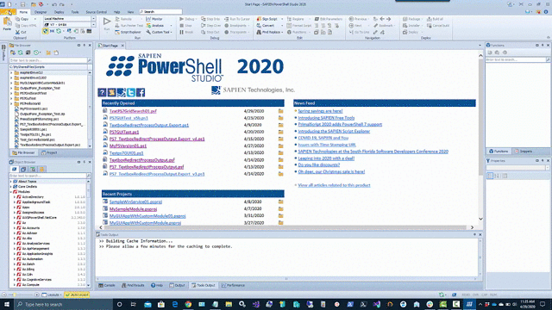
PowerShell Studio
Creating Scripts and PowerShell Tools
Create PowerShell GUIs.
Convert scripts into executable (.exe) files.
Create MSI installers.
Create modules from your existing functions or help files.
Create advanced functions using the Function Builder.
Create windows services using PowerShell.
Monitor script performance and memory usage.
Source Control and Git integration.
Integrated PowerShell consoles (32-bit & 64-bit).
Remote debugging.
Built-in PowerShell help.
Supports Windows PowerShell 3.0, 5.1 and PowerShell 7.
Code Formatting.

Slide 8
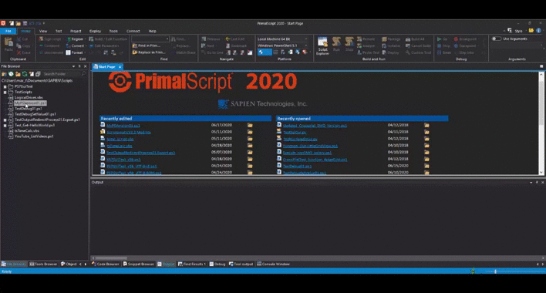
PrimalScript
Supports over 50 languages and file types.
Supports 32-bit and 64-bit platform development.
Next generation PowerShell local and remote debugger.
Supports PowerShell V3, V4 and V5 at the same time.
Script against a remote machine’s Installed Module Set (IMS).
Remote VBScript, JScript and PowerShell debugger.
Supports PowerShell variable and function breakpoints.
Integrated 32-bit and 64-bit PowerShell and command console.
PowerShell dialog editor.
Multi-file and module debugging.
Single click build for packages, MSI databases and deployment.
Plus much more.

Slide 9
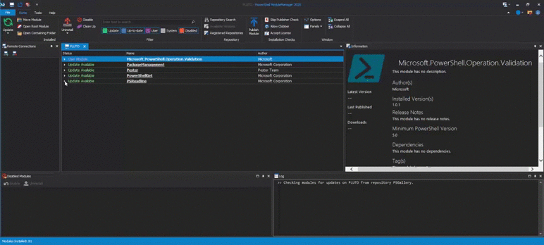
PowerShell ModuleManager
Search the PowerShell Gallery or any other repository for new modules.
Remove duplicate and outdated versions of modules to prevent version confusion.
Install, remove or temporarily disable modules.
Keep modules up-to-date.
Filter and find specific modules on your machine.
View detailed module information at a glance.
Move and organize module locations.
Manage modules on remote machines.
Publish modules to a repository.

Slide 10
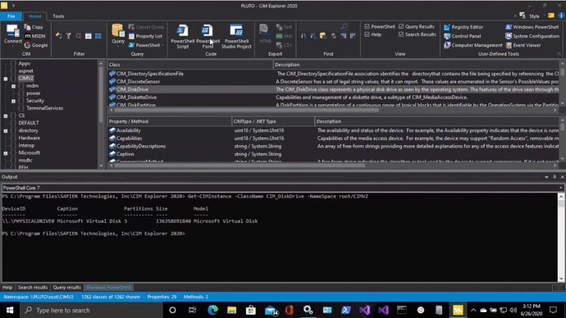
CIM Explorer
Preset and custom queries let you not only examine the classes, properties and methods but also the underlying data.
Generates sample code for PowerShell (GUI & non-GUI), and VBScript, including calls to CIM methods.
A large variety of search options to access the information faster and more precisely.
Superior performance using cached data and multi-threaded code gets you results fast.
Local cache allows you to browse remote machines even when not connected.
Filters allow you to reduce noise and focus only on relevant information.
Explore and query local and remote machines.
View all documentation for any WMI object.

Slide 11
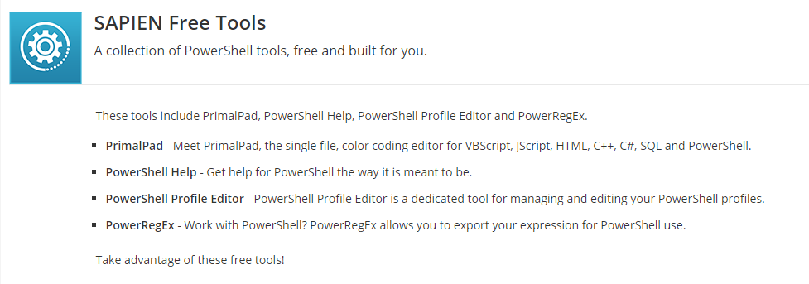

Slide 12
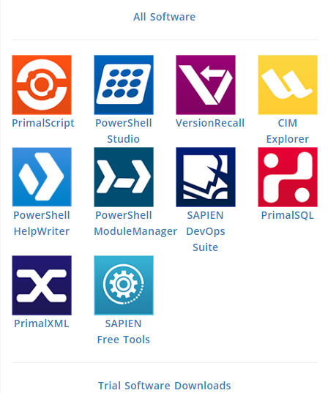
For Information
email: sales@sapien.com
Visit our website: www.sapien.com

Slide 13
About Windows Subsystem for Linux

Slide 14
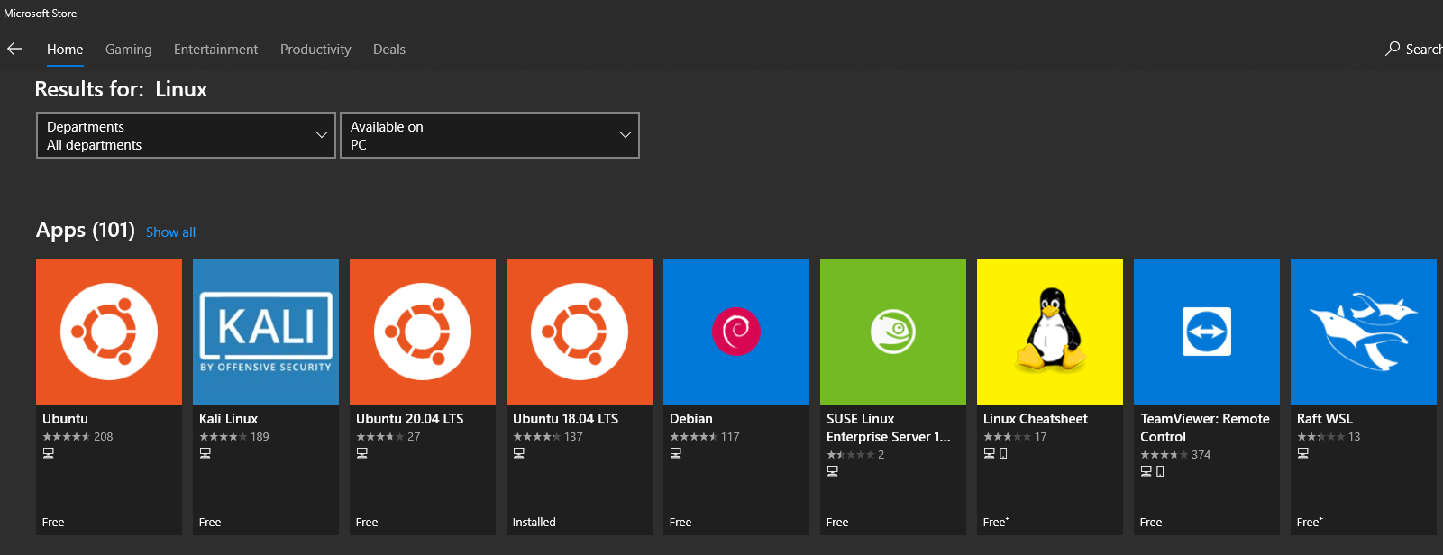
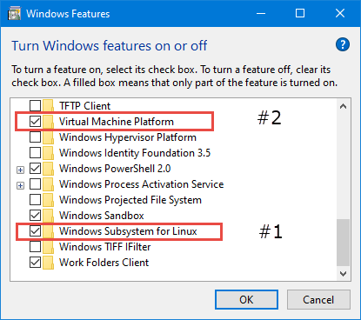
WSL 2 Requirements:
Requires Windows 10 Version 2004, or use the latest Windows 10 Insider Edition.
Add Windows Features: Windows Subsystem for Linux and Virtual Machine Platform.
Pick a Linux Distro from the Microsoft Sore.
More WSL information: https://docs.microsoft.com/en-us/windows/wsl/wsl2-index

Slide 15
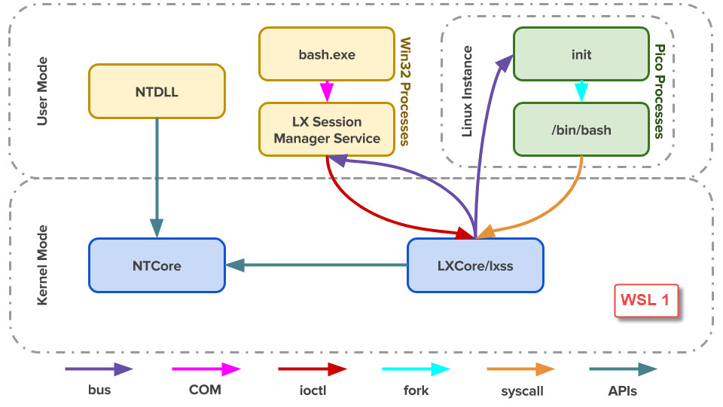
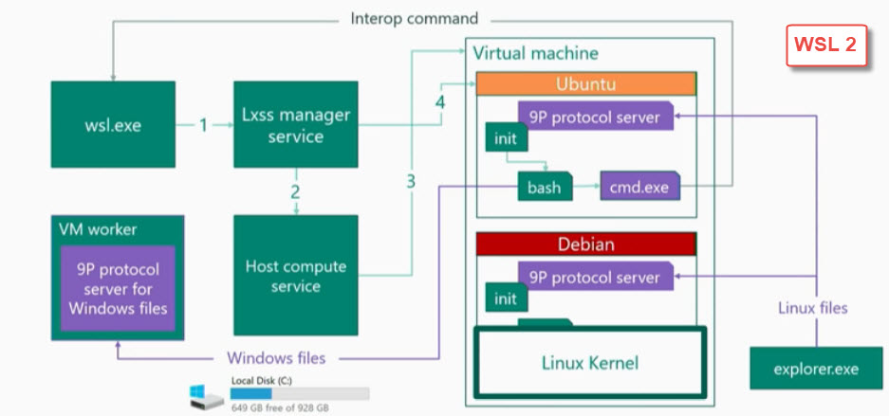
WSL 1 vs. WSL 2
Major differences:
WSL 1 is based on translation, and utilized Windows hardware.
WSL 2 is based on virtualization (True Linux Kernel: Ubuntu, SUSE, Kali…).

Slide 16
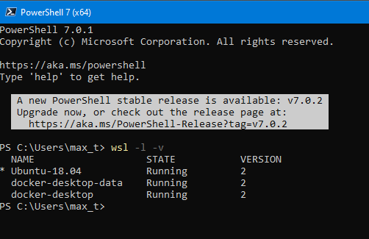

WSL 1 vs. WSL 2
Major differences:
WSL 1 can't connect to shared folders.
WSL 1 can use Linux Desktop GUI but is not supported.
WSL 1 has a slower I/O.

Slide 17
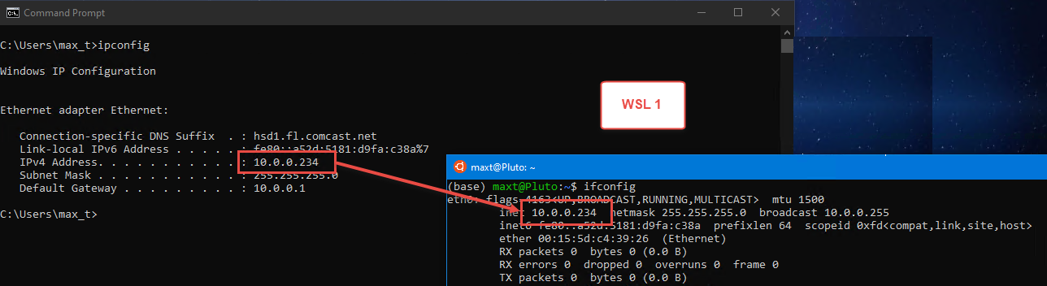
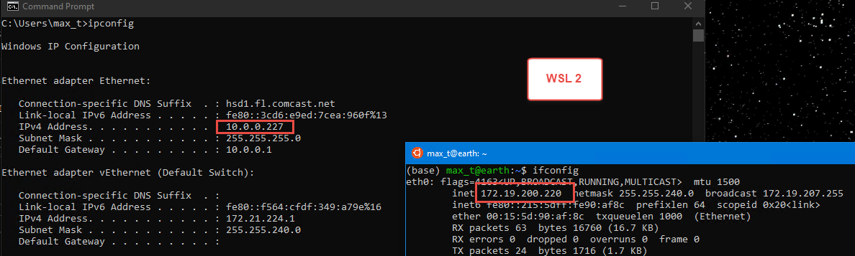
WSL 1 vs. WSL 2
Major differences:
Remoting between WSL: WSL 1 <> WSL 2.

Slide 18
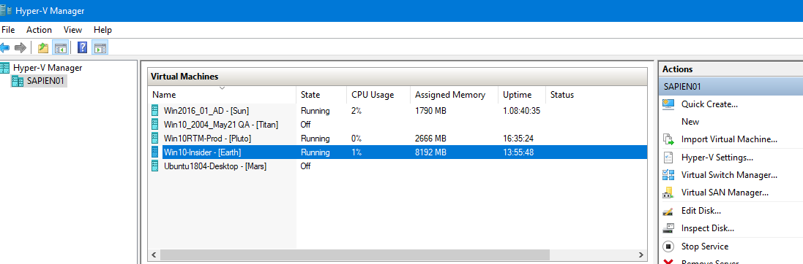
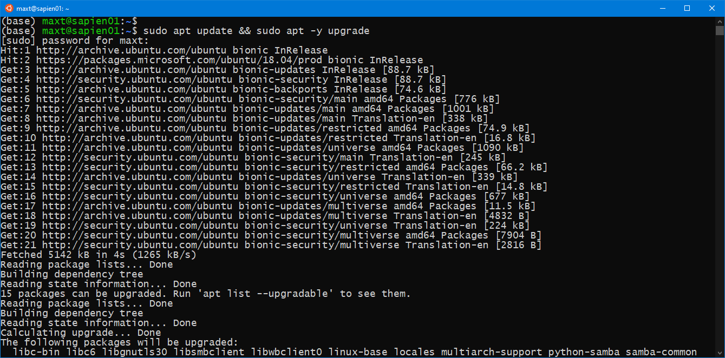
Additional Tips
On the physical machine:
System BIOS: Set enable virtualization.
In Hyper-V Windows 10 VM’s:
need to run the PowerShell cmdlet: Set-VMProcessor.
PS> Set-VMProcessor -VMName [HyperV-VMName] -ExposeVirtualizationExtensions $true
Update WSL distro after installation
Run command:
sudo apt update && sudo apt -y upgrade

Slide 19

WSL 2 Advantages
Faster file I/O performance (up to 3 to 6 times)
100 % System call compatibility
Powered by Linux Kernel
GPU support for performing rapid mathematical calculations for apps involving Data Science, Artificial Intelligence (AI), and Machine Language (ML).
Learn Linux in Windows 10.

Slide 20
What’s coming by the end of 2020?
Linux GUI apps will be supported.
Check out video about WSL 2, and sample container:
https://channel9.msdn.com/Shows/Tabs-vs-Spaces/WSL2-Code-faster-on-the-Windows-Subsystem-for-Linux?term=WSL2&lang-en=true
https://github.com/craigloewen-msft/ghostgame

Slide 21
WSL Demo

Slide 22
About Docker Container

Slide 23

Docker Containers
Ability to build containerized application for CI/CD (Continues Integration / Continues Deployment).
Ability to reuse docker containers existing repositories thru Docker Hub.
Easly integrates with Windows and WSL.
Use in On-Premise, Virtualization, and any Cloud technologies.
Docker Desktop - Two versions available: Stable and Edge (Preview).
New in Docker Edge Preview – Run an Azure Container Instance: https://www.docker.com/blog/running-a-container-in-aci-with-docker-desktop-edge/
For information check Docker Docs: https://docs.docker.com/

Slide 24
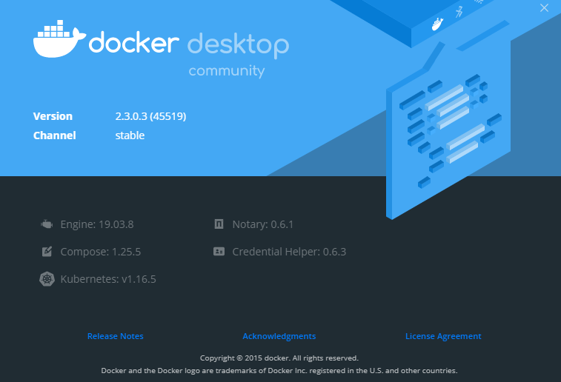
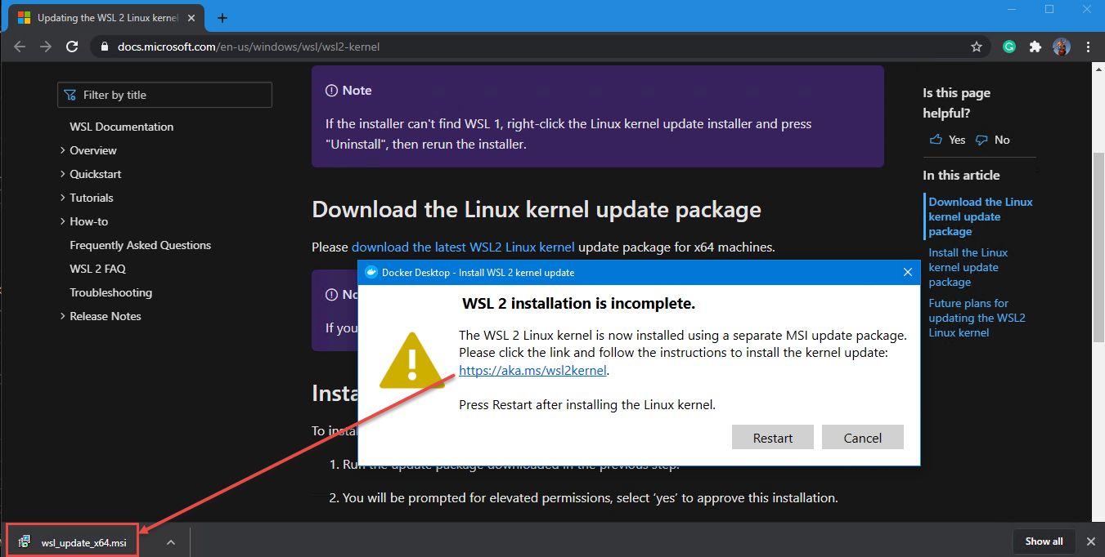
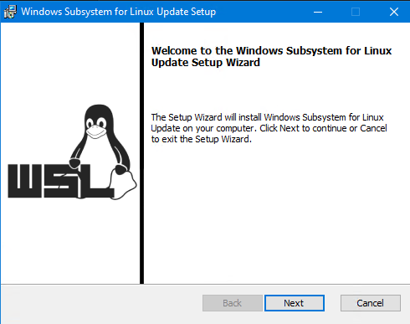
Two installations available
Docker Desktop
Stable – Updated every three months.
Edge – Updates are frequent.
Note: WSL update is required!

Slide 25



Docker Samples
Docker Engine CLI:
Pulling the MS SQL Server image to your system.
Run and Update the container.
Creating new container image.
Docker Compose:
Use new container image.

Slide 26
Docker Demo

Slide 27
Technologies At Play
Working with PowerShell Editor at hand: PrimalScript, PowerShell Studio, VS Code, ISE, or others.
Use WSL to learn about building cross-platform automation scripts.
Learn How-To remote between WSL, Windows and Linux systems.
Use Anaconda Jupyter Notebook with .NET Interactive to document your results.

Slide 28
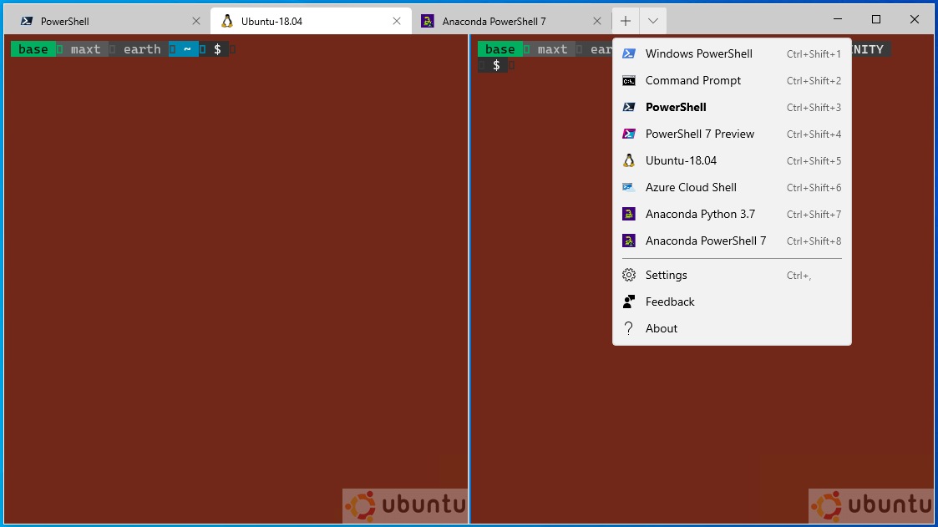
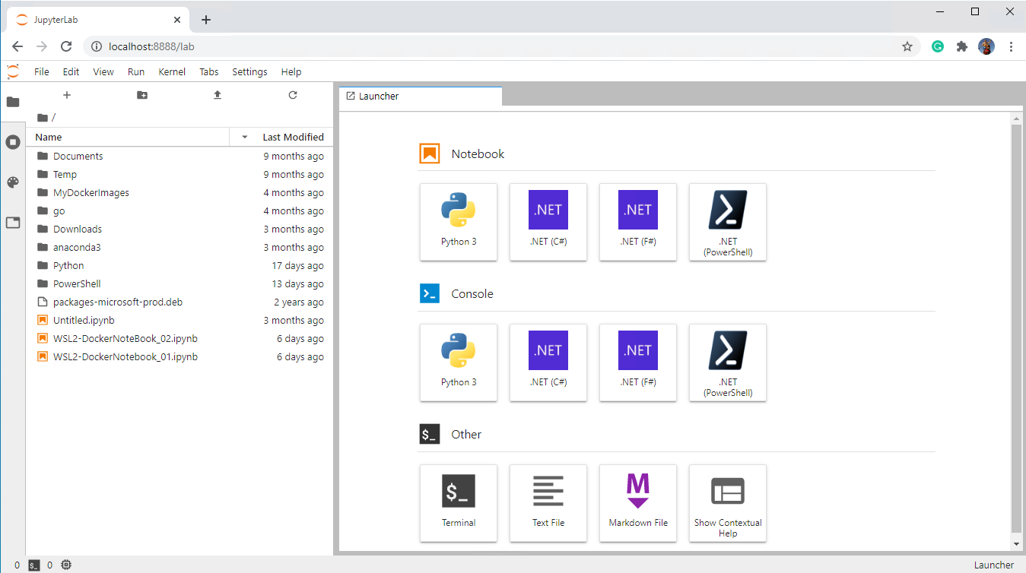
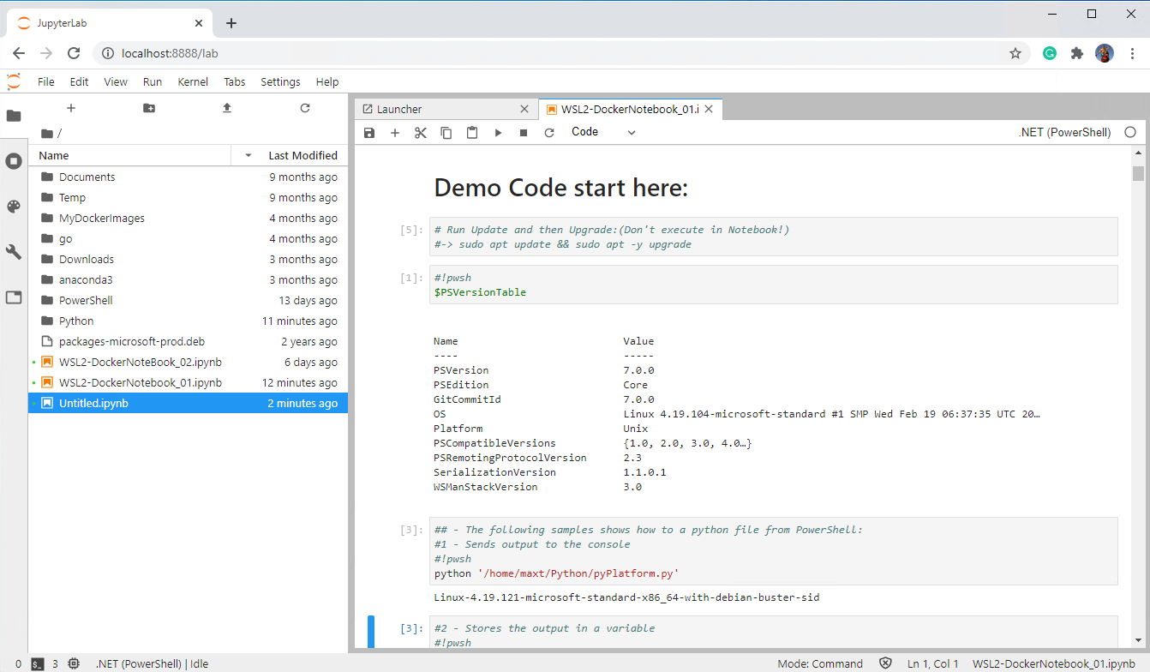
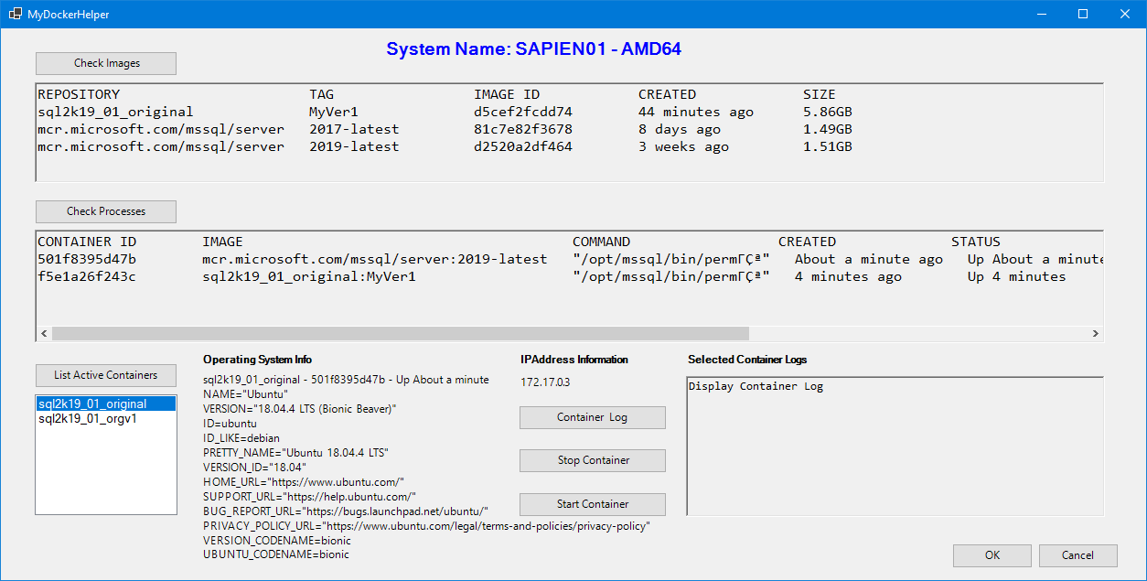
Expanding Your Skills!
Windows Terminal (Stable and Preview)
Stable version – Updated quarterly
Preview – Frequent updates
Customized console settings
Install Anaconda – Data Science Platform
Cross-platform development: Windows and Linux
Bundled with:
Python (2.7 or 3.7) with python packages
Jupyter Notebook
Support PowerShell
.NET Interactive
Available kernels available for Jupyter Notebook
F#
C#
PowerShell
Create useful Windows Application
PowerShell Studio Form Sample

Slide 29
.NET Interactive
Two ways to work with Jupyter Notebook:
1. Download and install - Anacoda w/Python 3.7.x (includes Jupyter Notebook) then install .NET Interactive Preview with PowerShell Jupyter Notebook.
https://devblogs.microsoft.com/powershell/public-preview-of-powershell-support-in-jupyter-notebooks/
https://devblogs.microsoft.com/dotnet/net-interactive-is-here-net-notebooks-preview-2/
2. Or, try using “MyBinder” (No installation required) to test-drive .NET Notebook: https://mybinder.org/v2/gh/dotnet/interactive/master?urlpath=lab

Slide 30
Demo – Technologies At Play

